Slide 1
6 – Generalization bounds

Slide 2
Motivation
In the lecture block on Function Approximation and Supervised Learning, we identified the following inequality for the risk:
$$R\left(\hat{h}\right)≤\sup_{h∈ℋ}\left|R\left(h\right)−\hat{R}\left(h\right)\right|+\inf_{g∈ℋ}{\hat{R}\left(g\right)}$$
The second term is the interpolation error. In the Deep Neural Networks block, we introduced the concept of affine pieces to bound it!
But how can we bound the first term: the generalization error?

Slide 3
Content
Reminder: Hoeffding’s inequality
PAC learning
Covering numbers
Overfitting in the under-and overparametrized regime
Appendix: VC dimension

Slide 4
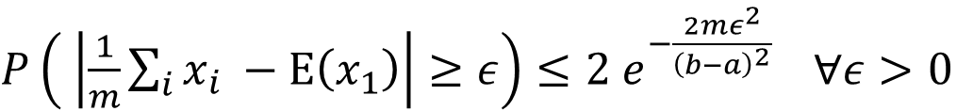
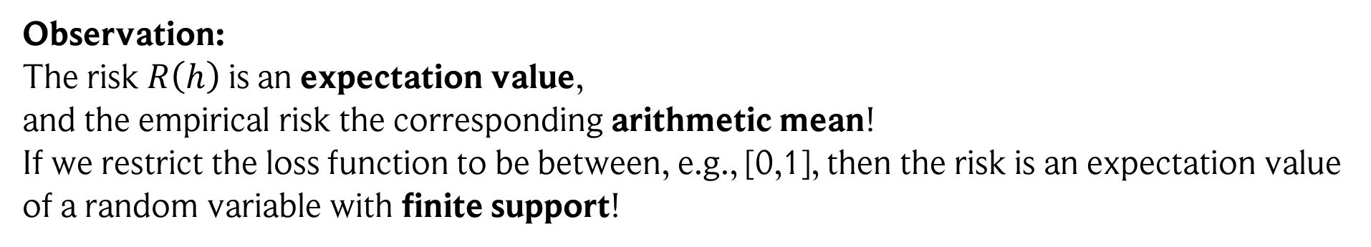
Return of the Hoeffding’s inequality
In the lecture block Foundations of Probability Theory, we discussed Hoeffding’s inequality:
Hoeffding’s inequality: Assume independent random variables $x_{1}, x_{2}, …, x_{m}$from the same distribution and finite support $x∈\left[a,b\right]$. Then:
$P\left( \left|\frac{1}{m}\sum_{i}{x_{i}} −E\left(x_{1}\right)\right|≥ε\right)≤2 e^{−\frac{2mε^{2}}{{\left(b−a\right)}^{2}} } ∀ε>0$
Observation: The risk $R\left(h\right)$ is an expectation value,
and the empirical risk the corresponding arithmetic mean!
If we restrict the loss function to be between, e.g., [0,1], then the risk is an expectation value of a random variable with finite support!
Hoeffding’s inequality applies! :)

Slide 5
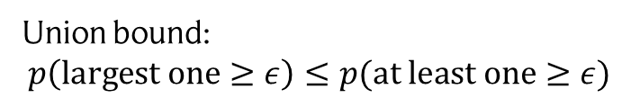


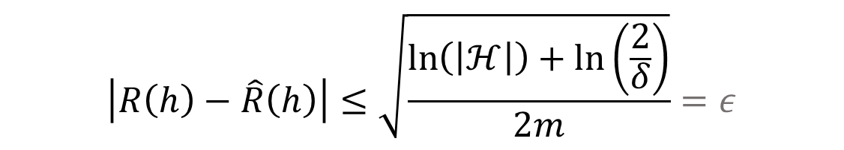


Learning bound: finite hypothesis set
Equipped with this knowledge, lets assume we have a finite hypothesis set $ℋ$. We start with the probability that the supremum is larger than some certain error $ε>0:$
$$≤\sum_{h∈ℋ}{p\left(\left|R\left(h\right)−\hat{R}\left(h\right)\right|≥ε\right) }$$
$$≤\sum_{h∈ℋ}{2}e^{−2mε^{2}}$$
$$p\left(\sup_{h∈ℋ}\left|R\left(h\right)−\hat{R}\left(h\right)\right|≥ε\right)$$
$$≤\left|ℋ\right|2e^{−2mε^{2}}=δ$$
Union bound: $$p\left(largest one≥ε\right)≤p(at least one≥ε)$$
Hoeffding
# training samples
With this, we get:
Let $ℋ$ be a finite hypothesis set. Then for every $δ>0$, the following inequality holds with probability at least $1−δ$ for all $h∈ℋ$:
$$\left|R\left(h\right)−\hat{R}\left(h\right)\right|≤\sqrt{\frac{\ln\left(\left|ℋ\right|\right)+\ln\left(\frac{2}{δ}\right)}{2m}}=ε$$

Slide 6


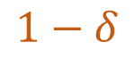
PAC Learning
Learning algorithms that have such a learning bound are also known as PAC learnable:
Probably Approximately Correct
$$1−δ$$
$$ε$$
We can squeeze out some more by solving $ε$ for the number of training samples $m$:
Let $ℋ$ be a finite hypothesis set. Then for every $δ>0 and$ $ε>0$, we have for all $h∈ℋ$
$p\left(\left|R\left(h\right)−\hat{R}\left(h\right)\right|≤ε\right)≥1−δ$
if we have at least $m≥\frac{\ln\left(\left|ℋ\right|\right)+\ln\left(\frac{2}{δ}\right)}{2ε}$ training samples.

Slide 7
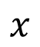
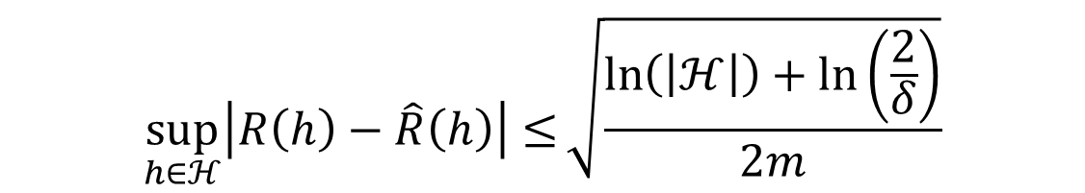
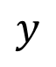
Problem: what happens in the limit of infinite hypotheses?
$$\sup_{h∈ℋ}\left|R\left(h\right)−\hat{R}\left(h\right)\right|≤\sqrt{\frac{\ln\left(\left|ℋ\right|\right)+\ln\left(\frac{2}{δ}\right)}{2m}}$$
The bound goes to infinity!
But why? Obviously linear regression, neural networks, etc. all generalize to some degree!
Reason: we assumed independence of the hypotheses! But what if two hypotheses have similar outputs / risk? We shouldn’t count them separately!
$$y$$
Illustration: classification
All lines lead to the same classification / similar risk!
Thus, instead of counting them individually, we should count them as “one class” of “equivalent” functions!
$$x$$

Slide 8
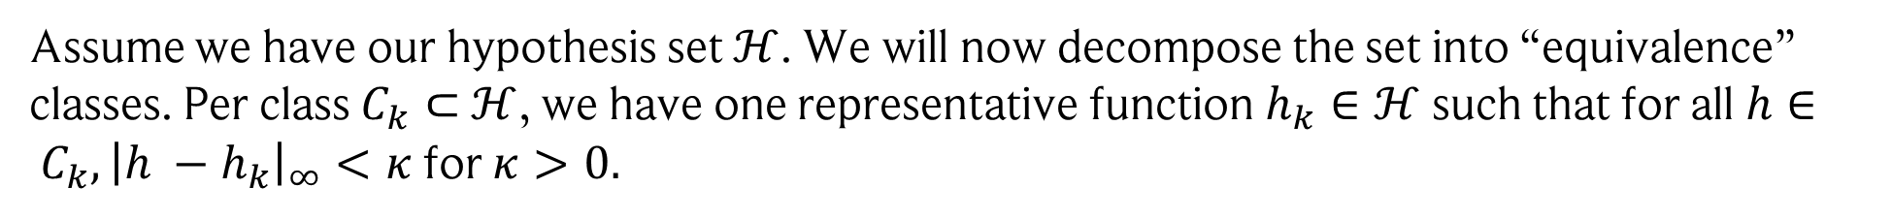
Covering number
Let’s formalize this!
Assume we have our hypothesis set $ℋ$. We will now decompose the set into “equivalence” classes. Per class $C_{k}⊂$ $ℋ$, we have one representative function $h_{k}∈ℋ$ such that for all $h∈ C_{k}, {\left|h −h_{k}\right|}_{∞}<κ$ for $κ>0.$
The covering number $d_{C}(ε)$ is the minimum number of classes $k$ required to fully cover $ℋ$, i.e., such that $\bigcup_{i=1}^{k}{C_{k}}=ℋ.$

Slide 9
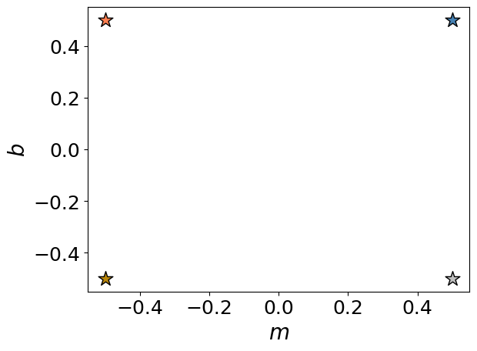
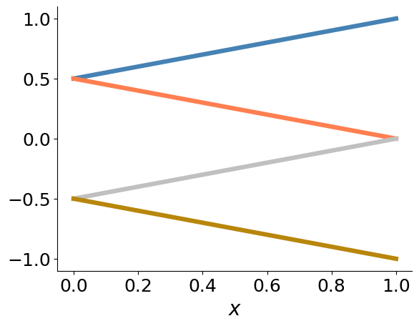
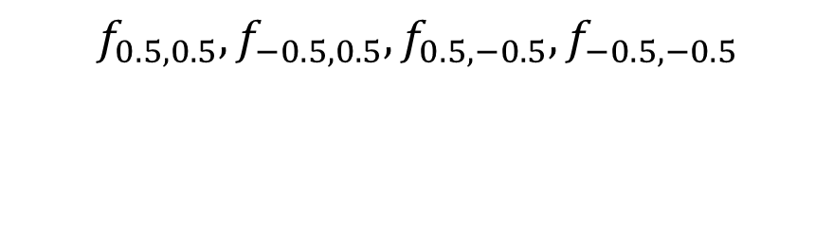
Example
Linear regression: $f_{m,b}\left(x\right)=mx+b$ with $m∈\left[−0.5, 0.5\right], b∈\left[−0.5, 0.5\right], x∈\left[0,1\right].$
Assume $ε=0.5.$ Then the following four functions cover all realizations of $f:$
$$f_{0.5,0.5},f_{−0.5,0.5},f_{0.5,−0.5},f_{−0.5,−0.5}$$

Slide 10

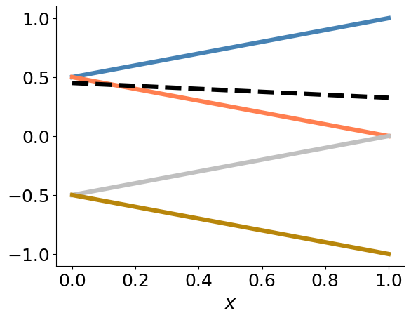
Example
Linear regression: $f_{m,b}\left(x\right)=mx+b$ with $m∈\left[−0.5, 0.5\right], b∈\left[−0.5, 0.5\right], x∈\left[0,1\right].$
Assume $ε=0.5.$ Then the following four functions cover all realizations of $f:$
$$f_{0.5,0.5},f_{−0.5,0.5},f_{0.5,−0.5},f_{−0.5,−0.5}$$

Slide 11
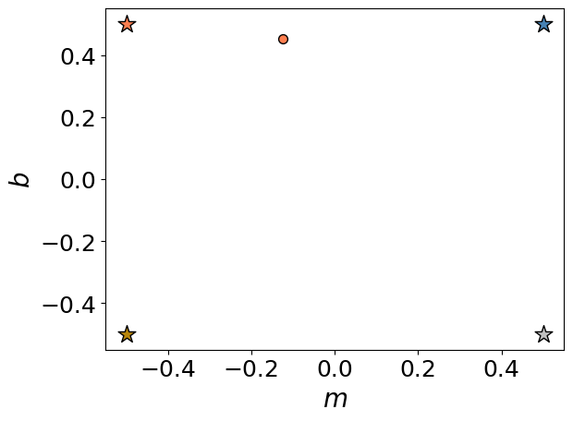
Example
Linear regression: $f_{m,b}\left(x\right)=mx+b$ with $m∈\left[−0.5, 0.5\right], b∈\left[−0.5, 0.5\right], x∈\left[0,1\right].$
Assume $ε=0.5.$ Then the following four functions cover all realizations of $f:$
$$f_{0.5,0.5},f_{−0.5,0.5},f_{0.5,−0.5},f_{−0.5,−0.5}$$

Slide 12
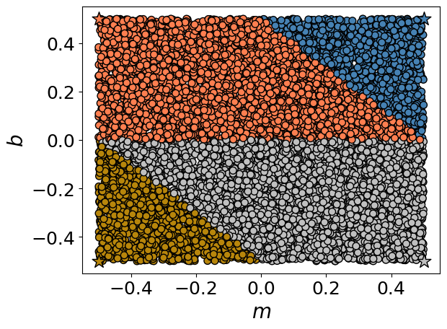

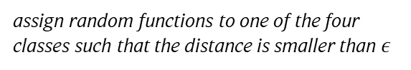
Example
Linear regression: $f_{m,b}\left(x\right)=mx+b$ with $m∈\left[−0.5, 0.5\right], b∈\left[−0.5, 0.5\right], x∈\left[0,1\right].$
Assume $ε=0.5.$ Then the following four functions cover all realizations of $f:$
assign random functions to one of the four classes such that the distance is smaller than $ε$
$$f_{0.5,0.5},f_{−0.5,0.5},f_{0.5,−0.5},f_{−0.5,−0.5}$$
The four functions cover $𝓗!$

Slide 13
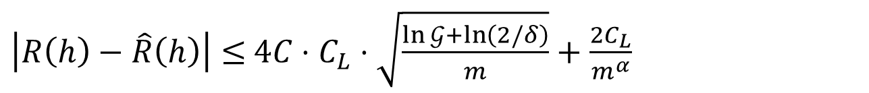
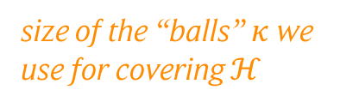
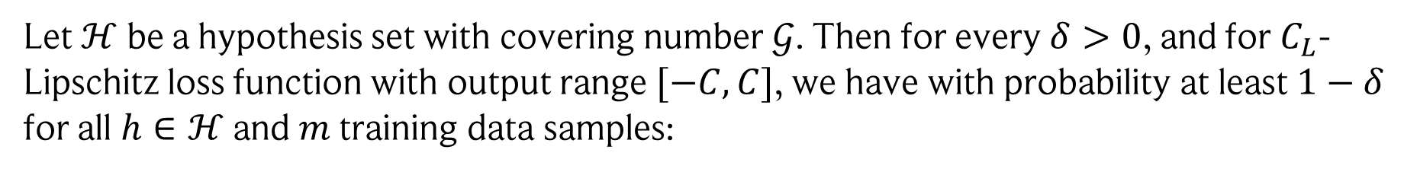
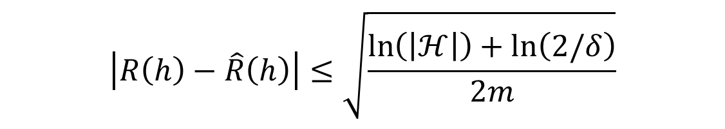
Learning bound: covering numbers
Previously, we had:
Let $ℋ$ be a finite hypothesis set. Then for every $δ>0$, the following inequality holds with probability at least $1−δ$ for all $h∈ℋ$:
$$\left|R\left(h\right)−\hat{R}\left(h\right)\right|≤\sqrt{\frac{\ln\left(\left|ℋ\right|\right)+\ln\left(2/δ\right)}{2m}}$$
Using covering numbers, we get (using a rather similar derivation):
Let $ℋ$ be a hypothesis set with covering number $𝒢$. Then for every $δ>0$, and for $C_{L}$-Lipschitz loss function with output range $[−C, C]$, we have with probability at least $1−δ$ for all $h∈ℋ$and $m$ training data samples:
$\left|R\left(h\right)−\hat{R}\left(h\right)\right|≤$ $4{C⋅C}_{L}⋅\sqrt{\frac{\ln{𝒢}+\ln\left(2/δ\right)}{m}}+\frac{2C_{L}}{m^{α}}$
size of the “balls” $κ$ we use for covering $ℋ$

Slide 14

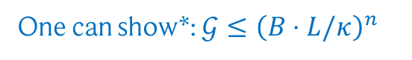

Covering numbers from Lipschitz constants
If our neural network is Lipschitz continuous (which it is for most activation functions used in practice),
then there is a clever way of bounding the covering number!
Let $f_{w}\left(x\right), w∈\left[−B,B\right],$be Lipschitz in the parameters: $\left|f_{w′}\left(x\right)−f_{w′′}\left(x\right)\right|≤L \left|w′−w^{′′}\right| ∀x$
Now we find the covering number for the parameter space, i.e., we find the minimum number of weights $w_{i}$ such that for all $w∈\left[−B,B\right]$, there is at least one $w_{i}$ with $\left|w−w_{i}\right|≤\frac{κ}{L}$.
Cover parameter domain with “balls” of size $κ/L$.
One can show*: $𝒢≤{\left(B⋅L/κ\right)}^{n}$
$n$: # parameters
*using the Supremum norm.
Image credit: Philipp Petersen, Jakob Zech. Mathematical theory of deep learning (2025)

Slide 15

Covering numbers from Lipschitz constants
If our neural network is Lipschitz continuous (which it is for most activation functions used in practice),
then there is a clever way of bounding the covering number!
Let $f_{w}\left(x\right), w∈\left[−B,B\right],$be Lipschitz in the parameters: $\left|f_{w′}\left(x\right)−f_{w′′}\left(x\right)\right|≤L \left|w′−w^{′′}\right| ∀x$
Now we find the covering number for the parameter space, i.e., we find the minimum number of weights $w_{i}$ such that for all $w∈\left[−B,B\right]$, there is at least one $w_{i}$ with $\left|w−w_{i}\right|≤\frac{κ}{L}$.
Then, through the Lipschitz property, we have $\left|f_{w}\left(x\right)−f_{w_{i}}\left(x\right)\right|≤κ$, i.e., we also covered $ℋ!$
Cover parameter domain with “balls” of size $κ/L$.
One can show*: $𝒢≤{\left(B⋅L/κ\right)}^{n}$
Through the Lipschitz property, we also get a covering of $ℋ.$
$n$: # parameters
*using the Supremum norm.
Image credit: Philipp Petersen, Jakob Zech. Mathematical theory of deep learning (2025)

Slide 16
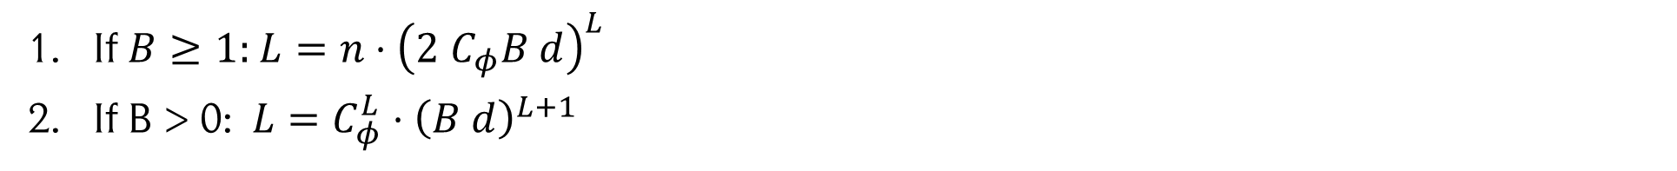
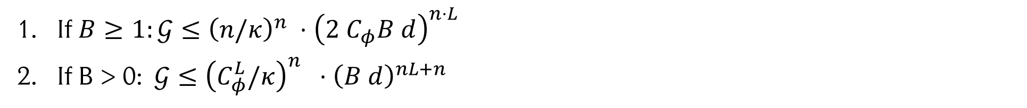
Finale: Lipschitz constant of ReLU neural networks
A ReLU neural network with $n$ parameters, max. width $d$, $L$ layers, an activation function with Lipschitz constant $C_{φ}$, and parameters constrained to $[−B,B]$, has Lipschitz constant:
If $B≥1:$ $L=n⋅{\left(2 C_{φ}B d\right)}^{L}$
If B > 0: $L=C_{φ}^{L}⋅{\left(B d\right)}^{L+1}$
From which we get the covering numbers, e.g.,:
If $B≥1:𝒢≤{\left(n/κ\right)}^{n} ⋅{\left(2 C_{φ}B d\right)}^{n⋅L}$
If B > 0: $𝒢≤{\left(C_{φ}^{L}/κ\right)}^{n} ⋅{\left(B d\right)}^{nL+n}$
These can be simply inserted into our generalization bounds!

Slide 17
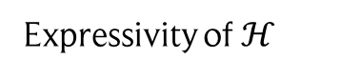
Outro: data science in the overparametrized regime
Classical piece of wisdom: the more parameters your model has, the more expressive it is. However, with many more parameters than training data, it will start overfitting!
Risk
Empirical risk
Underfitting
Overfitting
Expressivity of $ℋ$
Image adapted from: Philipp Petersen, Jakob Zech. Mathematical theory of deep learning (2025)

Slide 18
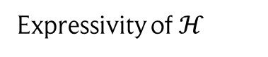
Outro: data science in the overparametrized regime
Classical piece of wisdom: the more parameters your model has, the more expressive it is. However, with many more parameters than training data, it will start overfitting!
Classical regime
Modern regime
Risk
Empirical risk
Underfitting
Overfitting
Expressivity of $ℋ$
However, in practice we observe that highly overparametrized models can generalize well!
A famous phenomena is the above curve, called “double descent” .
Note that this phenomenon is not exclusive to neural networks: one can recreate it for linear models, polynomials, regression with basis functions, etc.!
There are several explanations for this behaviour … we will briefly touch on one of them.
Image adapted from: Philipp Petersen, Jakob Zech. Mathematical theory of deep learning (2025)

Slide 19
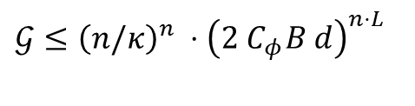
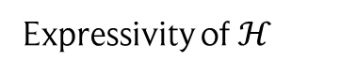


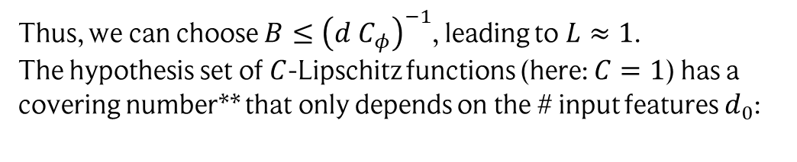
One explanation: the power of many, small parameters
Classical regime
Modern regime
Risk
Empirical risk
Underfitting
Overfitting
Expressivity of $ℋ$
Only few parameters, which potentially have to be large to fit the data. We have:
Many parameters, so they can be quite small* (large values are obtained by summing up many inputs!)
Thus, we can choose $B≤{\left(d C_{φ}\right)}^{−1}$, leading to $L≈1$. The hypothesis set of $C$-Lipschitz functions (here: $C=1$) has a covering number** that only depends on the # input features $d_{0}$:
$$𝒢≤{\left(n/κ\right)}^{n} ⋅{\left(2 C_{φ}B d\right)}^{n⋅L}$$
Generalization bound depends on # parameters!
$$\log{𝒢}≤ακ^{−d_{0}}$$
with constant $α>0$
Generalization bound is constant w.r.t. # parameters! We see a decrease since the empirical risk still improves.
* Note that most types of regularization ensure small weights (L1, L2, etc.)! We also often initialize neural networks with weight scales that depend on the width!
** Both bounds shown here are valid for both regimes. We get the “double” curve by choosing the bound that is smaller!
Image adapted from: Philipp Petersen, Jakob Zech. Mathematical theory of deep learning (2025)

